Slide 1
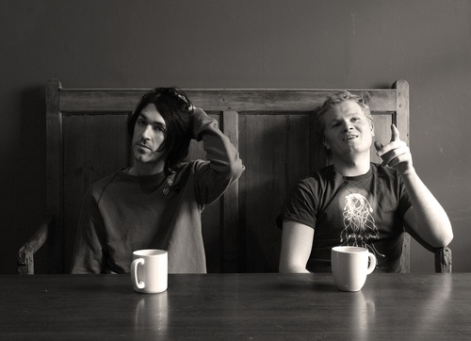
Duologues & sCENES
Drama
Year 9
Lesson 6 Rehearsals

Slide 2

LESSON AIM
To rehearse your scenes and identify areas which can be improved upon.

Slide 3

LESSON OUTCOME
LEVEL 4 – I will know I can rehearse my scene.
LEVEL 5 – I will understand I can rehearse my scene and identify areas which need improvement.
LEVEL 6 – I will be able to rehearse my scene, identify areas which need improvement and be able to refine my performance.

Slide 4

MR FREEZE
Clap = Stamp
Stamp = Clap
Jump = Spin
Spin = Jump
Stand Up = Sit Down
Sit Down = Stand Up
Go = Stop
Stop = Go
Walk = Jog
Jog = Walk
Star = Cross
Cross = Star
Mr Freeze is coming = stand perfectly still whilst Mr Freeze tries to make you move.

Slide 5
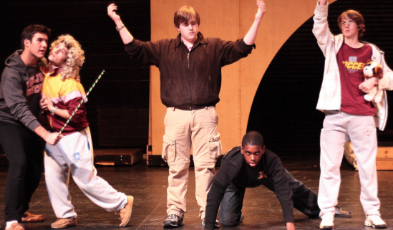
REHEARSALS
REMEMBER...
Staging
Stay In Role
Stay On Task
Characterisation
Use of words
Energy
Enjoy yourself...but work hard

Slide 6

CIRCLE TIME
Sit in whole class circle.
Feedback on the process of your group.

Slide 7
What have you achieved today? LESSON OUTCOME
LEVEL 4 – I will know I can rehearse my scene.
LEVEL 5 – I will understand I can rehearse my scene and identify areas which need improvement.
LEVEL 6 – I will be able to rehearse my scene, identify areas which need improvement and be able to refine my performance.

Slide 8
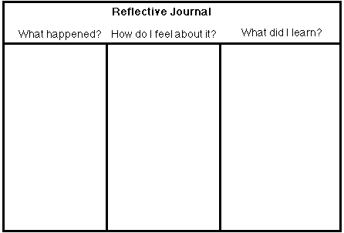
REFLECTIVE LOG
It is important to reflect on every lesson and begin thinking about setting targets for yourselves. For assessment it is important to keep a log book of activities, so you must write a reflective log for each lesson.

